Slide 1

DNSP View on Electric Vehicles
C4NET| November 2024

Slide 2

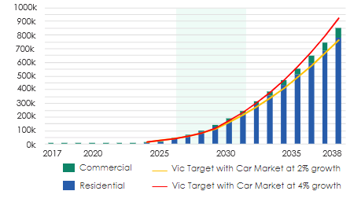





Rapid uptake of EVs across the globe has led to some common challenges, which Australia can learn from
Common Challenges Across the Globe
Charger infrastructure performance & availability:
Charging speeds and reliability of public infrastructure, and the adoption and availability infrastructure in rural areas.
Consumer barriers to adoption:
Understanding and mitigating consumer barriers to adoption, including range anxiety, affordability and access to reliable infrastructure.
EV grid integration and network impact:
Understanding the impacts of EV charging on the network supply, but also how to leverage EV integration for flexibility.
Technology and strategy maturity:
Low maturity of strategies to coordinate and manage EV impacts on the electricity networks, by both network utility providers and governments
Policy, Supply, and Market Dynamics
Navigating aggressive government decarbonization policies
Across AusNets network, EVs are expected to rise from 11,000 in 2024 to 245,000 in 2031 aligned to the Victorian government target.
Trends are highlighting that network planning, development, and operations will need to adapt quickly to keep up with the pace of change and increased network pressure.

Slide 3







There are significant risks to DNSPs if these challenges and our emerging customer needs are not managed well
Risks associated with the a ‘do noting’ option, or where DNSPs continue a BAU approach with the changing landscape for EVs
Delays in delivering necessary network and customer upgrades Impacts to electricity supply and delays in customer ability to buy or charge and EV.
Customer dissatisfaction with ability to charge when and how they wish Reputational damage and loss of social licence
Growing inequalities between regional and urban customers Electricity supply service, disproportionately affecting DNSP customer base
Funding Funding to drive network upgrades to enable the additional load growth brought on by EVs
Competitiveness for large EV charging infrastructure NSW networks vs Vic networks
Innovation EV policies, initiatives and investment limiting opportunities for innovation

Slide 4
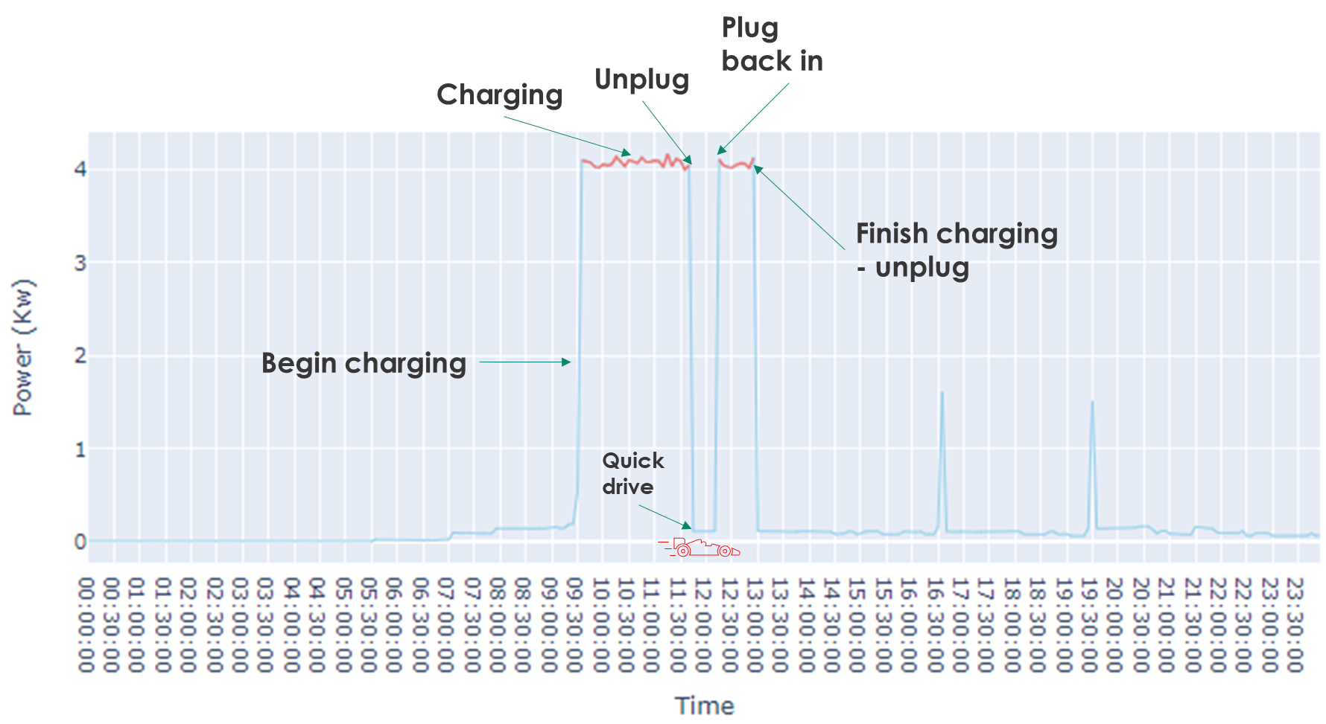
AusNet Initiatives Underway
EV Tariff Trial (2023-2026)
This initiative tests pricing signals and incentives to understand and shape EV charging behaviours, aiming to inform the design of future EV tariffs.
Customer Research (2023-2025)
This project gathers insights on customer needs and expectations for EVs to guide the next EDPR submission and develop a customer-focused EV strategy.
EV Pole Top Mounted Charger (2025)
Refining NSW designs to meet Victorian standards and exploring deployment strategies to enhance solar soak capabilities and support EV adoption.
EV Detection Algorithms (ongoing)
Identify EV charging patterns and optimise charging times, improving network efficiency by aligning demand with peak exporting hours.
New Estates (ongoing)
Test EV integration in greenfield developments, refining network designs and demand management strategies to support widespread EV adoption.
EV Detection

