Slide 1
Getting Charged and Ready: Placing Consumers in the Driving Seat to Power Up the Grid
ross de rango
head of energy and infrastructure

Slide 2

“Charge during the middle of day if you can,
or in the middle of the night if you can’t,
and please *not* on a hot afternoon unless you must”
Guidance from the evC….

Slide 3
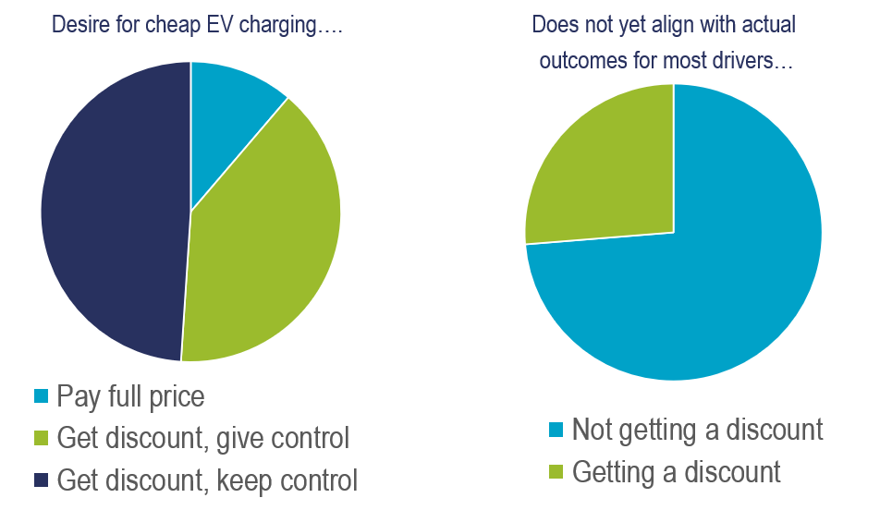
What do the consumers want? What are they doing?

Slide 4
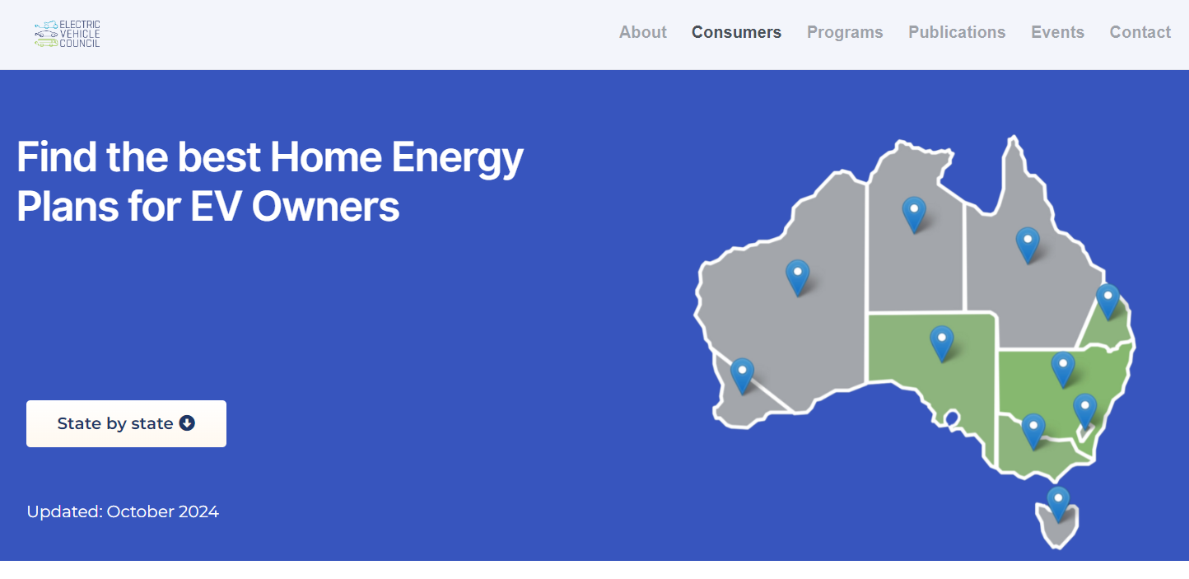
SO we built a thing…. AND we ARE ADVOCATING.

Slide 5
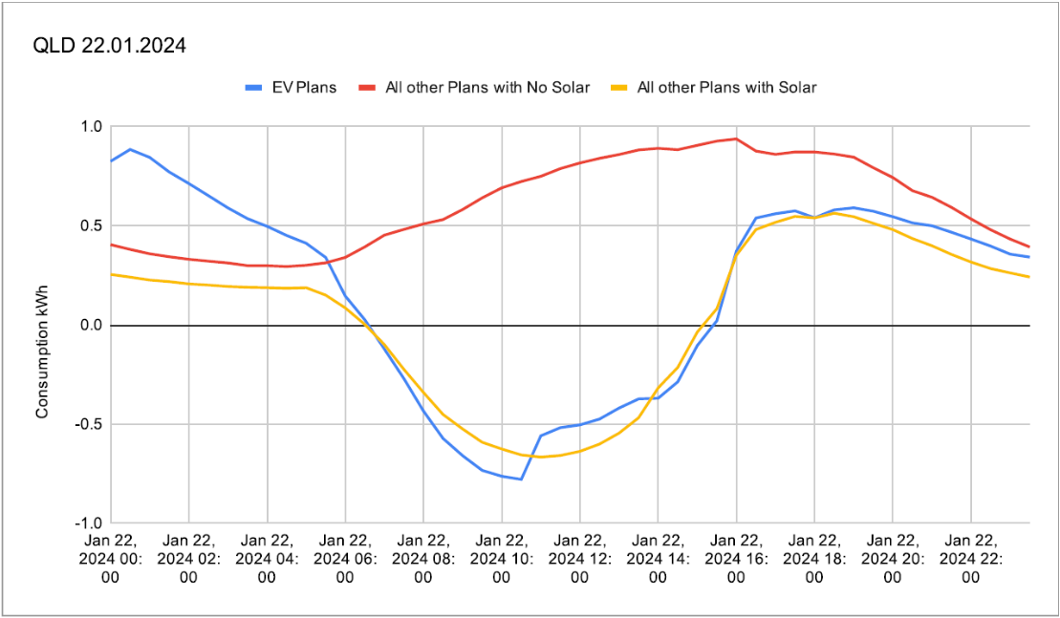
Reduced
consumption
at peak time
Increased
Consumption
Middle of night
Reduced export
Middle of day
What happens on the peakiest days?

